Slide 1

Education at the Core
Building a Safer, Sustainable Future for Yachting
www.guest-program.com
Notes:
Slide 1 – Intro
Two weeks ago I was part of a private group chat, where an HoD was asking for confirmation on the protocol to manage an issue with a Captain who had been bullying one of their team members, this individual had substantial evidence that this behaviour had been going on not with just one, but multiple crew members. After a number of phone calls and email to the DPA and the management company to take action, the captain was removed. The final words of thanks for the advice and support provided by the group included (and I quote) “I did Leadership Advanced course, with HR and Crew Wellbeing which are paying out with this experience, I gained more confidence of how to deal in this kind of situation, I believe every HOD should have these courses as mandatory on every size vessel – I must say - its money well spent” ,
Good afternoon everyone. Thank you to the PYA and sponsors for the opportunity to speak with you today.
I want to cover a topic that goes to the very heart of our industry: education, and how it underpins a safer, healthier, and more sustainable yachting sector.
My message today is simple:
“Investing in people is not optional, it’s essential. Without it we risk seeing a growth in flawed practices, diminished crew wellbeing and a widening gap between what’s promised to clients and what’s operationally possible for crew”

Slide 2
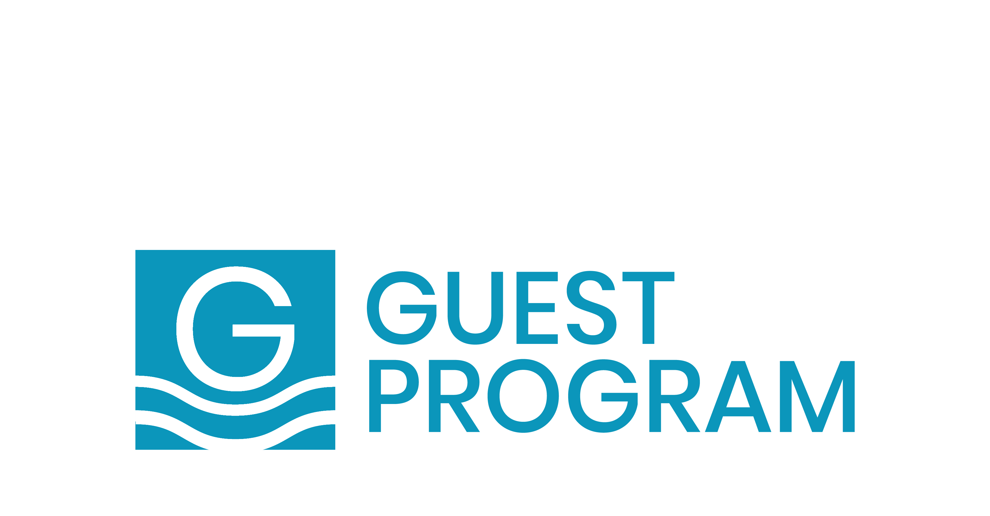
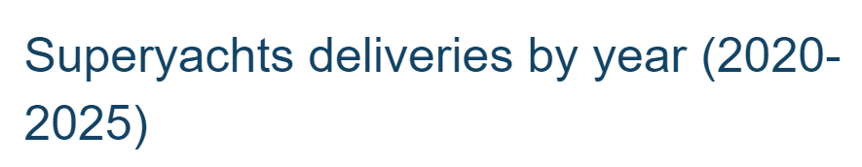

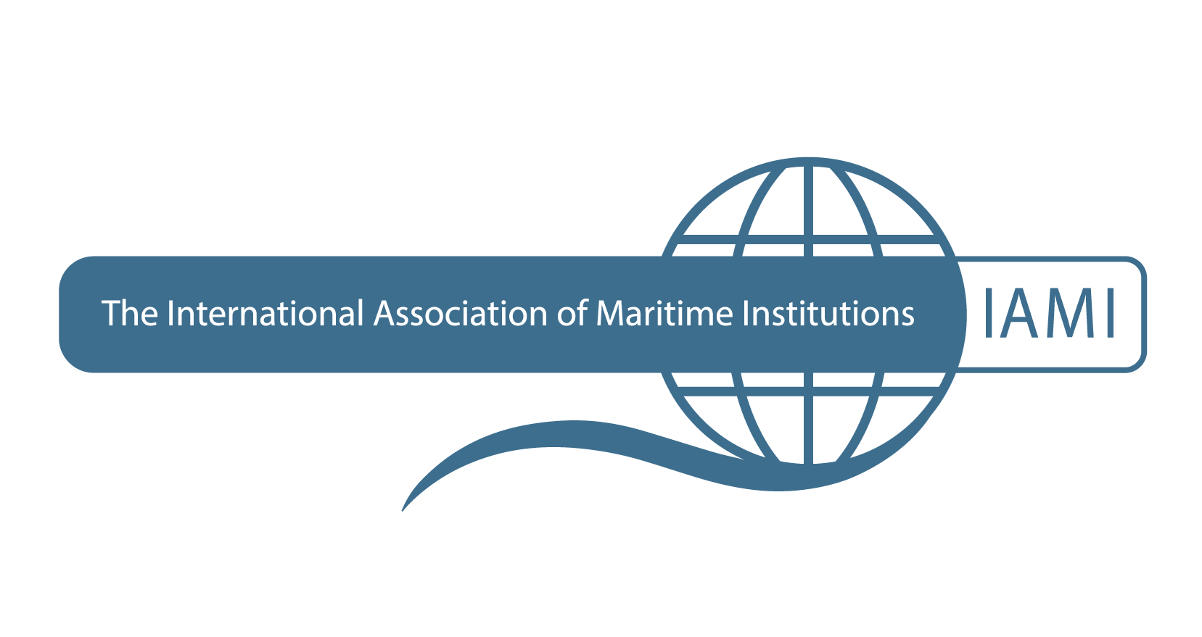
Something to Celebrate?
Sources: Based on Boat International & SuperYacht databases; * 2024 & 2025 estimations
Notes:
Slide 2 – Something to Celebrate
On the surface, the superyacht industry has never looked stronger… we seem to say this every year – and for good reasons - year on year, the fleet keeps growing.
From the outside, it looks like a success story… but is this really something to celebrate or is it a case that “appearances can be deceiving”.

Slide 3
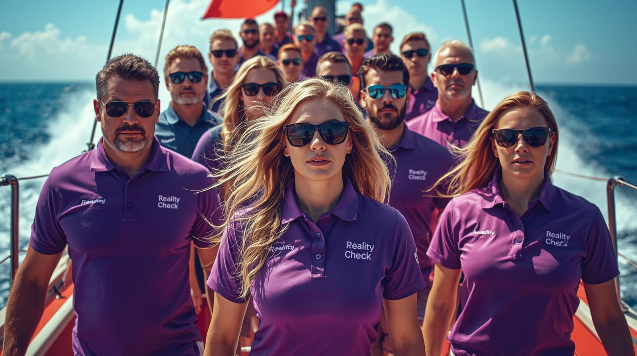
High-risk environment, day-to-day reality !
Exhausted crew, avoidable incidents raising
5-star service + vessel safety expected 24/7
Crew voicing serious safety concerns
Expectation gap - promises vs. operational reality
The Reality Check!
Yacht Crew Demanding Action ….
Notes:
Slide 3 – The Reality Check
We see the same pattern repeat itself every year: exhausted crew, corners cut, and avoidable incidents piling up.
But this isn’t just about long hours. The yachting industry, for all its unique opportunities, operates in a demanding and high-risk environment.
And while safety regulations exist on paper, the day-to-day reality can look very different.
We speak to crew daily, and more and more of them are raising serious concerns about their safety and wellbeing onboard. Some even look for new roles purely because they no longer feel safe in their current positions.
These aren’t minor issues. They are real experiences that erode confidence and push some of our best people out of the industry.
It is encouraging that some crew now feel more confident to speak up, and that many are knowledgeable enough to spot when procedures aren’t being followed. But we can’t ignore that these failures persist.
The human cost is exhaustion, anxiety, and risk. The business cost is reputational damage, higher insurance premiums, and increasing liability exposure.
It’s not just a human issue — it’s an operational and financial crisis waiting to happen.

Slide 4
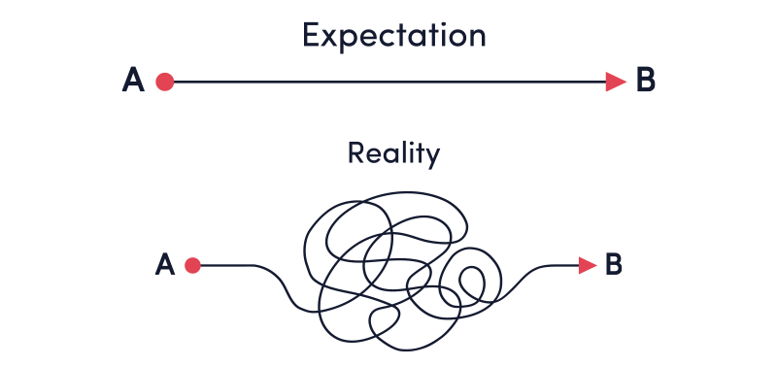
The Culprits
Overpromised Expectations
vs Operational Reality
+
Minimum Safe Manning
vs Operational Reality
+
Minimum STCW Training
vs Competency Reality
The Inconvenient Truth
Notes:
Slide 4 – The Inconvenient Truth
“Why is this happening”
The truth is the industry continues to overpromise — from a new builds lack of considerations to crew environments – to selling the impossible - just to secure another charter deal. Business expectations & outdated practises do not align with today’s operational realities
Minimum Safe Manning does not consider the Operational realities and Service expectations - yet is the benchmark most often used – such as during the yacht build as well as establishing the crewing positions.
Minimum Training does not consider the real-life Competencies needed across the onboard cohorts. STCW provides only the minimum foundation. It doesn’t fully prepare yacht crew for what they actually do!

Slide 5
The Human Element:
Yachting’s Strongest System is Crew
Human Element is not a Soft Skill it’s the most critical safety and service system we have!
Crew Roles:
safety, service, leadership, technical
Crew Responsibilities:
human life, assets, environment, business
Crew well-being directly impacts
operational safety
Industry must change its culture to recognising training as an asset investment, and not an added cost or bonus.
The Human Element
Notes:
Slide 5 – The Human Element
Let’s remember crew are the backbone of this industry.
They are expected to be service experts, technical operators, safety managers, and team leaders all at once.
And yet, we operate from minimum safe manning and minimum training standards that were never designed for the reality of yachting – yet alone modern yachting.
The most important system onboard isn’t mechanical or digital — it’s human.
The human element isn’t a ‘soft skill’. It’s the most critical safety and service system we have.
When crew well-being is neglected, safety is compromised. And when safety is compromised, operations, reputations, and ultimately lives are at risk.
The widening gap between business practices and expectations, and the regulatory minimums - leaves crew unprepared and the industry exposed.

Slide 6
The Ripple Effect - Tsunami
Operational cost: Avoidable incidents, unsafe practices, crew turnover
&
Human cost: fatigue, mental health,, lives at risk
&
Business cost: reputation, liability, premiums
This isn’t just a human issue — it’s a financial and operational one.
Consequences
Notes:
Slide 6 – Consequences
We’re seeing incidents that could have been avoided with better training and better support.
Insurers are reacting with stricter policies and higher premiums.
Reputational damage impacts yachts being viewed as high risk.
And with qualified crew leaving the industry, shortages and turnover are only getting worse.
Crew tell us about unsafe practices: from missed drills, carrying out dangerous jobs without proper equipment, to vulnerabilities around their welfare and even situations where they feel unsafe onboard.
The human cost is exhaustion, anxiety, and risk.
The business cost is reputational damage, liability exposure, and rising insurance premiums.
This isn’t just a human issue — it’s a financial and operational one.
And the cost of failing to invest in crew — is a cost that compounds across the entire industry.

Slide 7
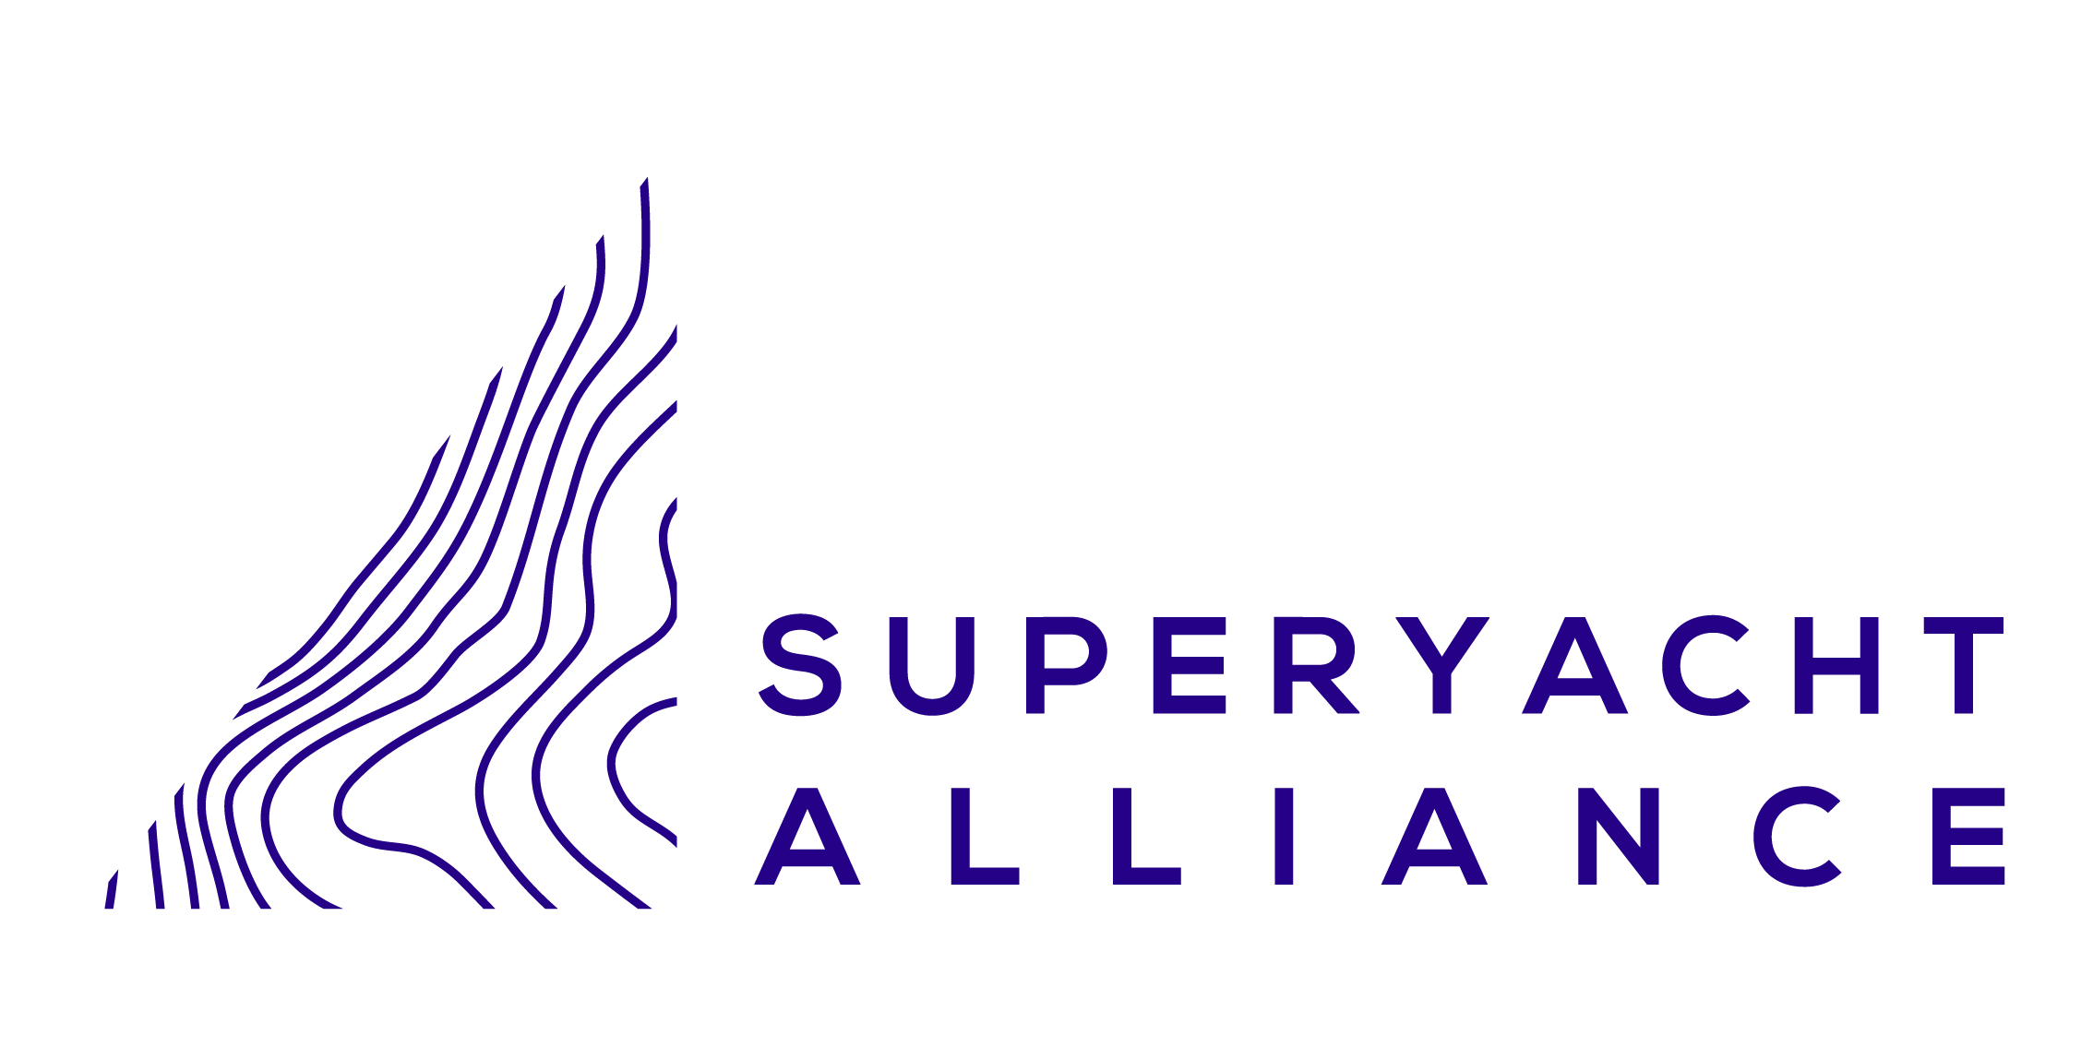
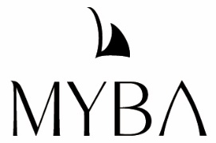
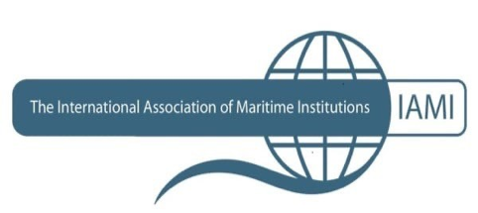
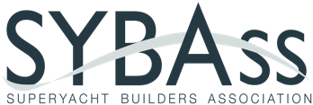
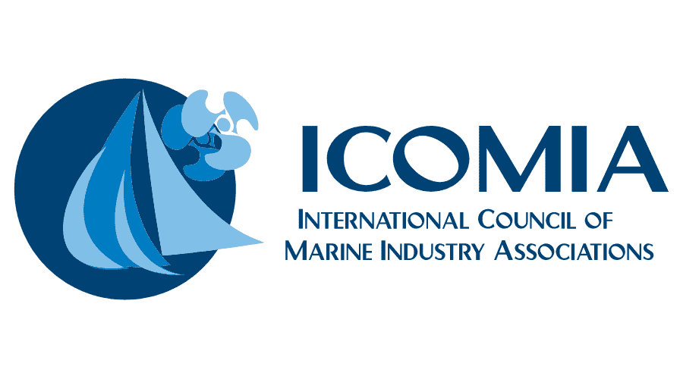
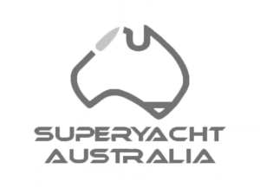
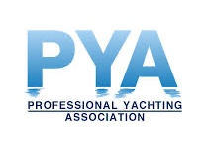
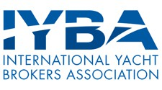
Superyacht Alliance For Professional Standards A strategic collaboration to reshape industry standards, ethics, & practices.
Change is Happening
Notes:
Slide 7 – Change is Happening
The good news is that change is already underway.
The Superyacht Alliance has united voices across the industry to push for a radical rethink of the yachting formula — one that reshapes industry standards, ethics and practices, aligning the purpose and sustainability of the industry by placing safety and luxury on the same level.

Slide 8
Alliance Think Tanks
Raising the Bar - Engaging, Inspiring & Retaining Superyacht Talent
Changing Tack on Crew Welfare - Health, Safety, & Wellbeing of Yacht Crew
Onboard Safety Operations - Operational Safety Standards for Safer, Sustainable Working Environments
Crew Workplace Culture - Advancing Workplace Protection, Cultural & Ethical Standards.
Change is Happening
Professional Registers
Superyacht Qualifications Framework
Notes:
Slide 8 – Change is Coming ….cont
Through the growing number of Targeted Alliance Think Tanks, run by committees, and with an open membership for anyone to be part of, we have 100s of industry specialists involved - from established organisations to passionate individuals – who are volunteering to tackle the various issues and concerns through Think Tank work group.
We have put a Professional Register in place, at this time we have the YORs listed, but this will in time grow to recognise professionals from all industry sectors.
Through some recent funding, we are building a Superyacht Qualifications Framework, recognising all professions across the industry, and where career pathways can be formally established, with education at the centre – this will lead to a more professional and sustainable future, for both the onboard and shore-based sectors.
This momentum is real — and will continue to accelerate.
Raising the Bar - Engaging, Inspiring & Retaining Superyacht Talent
Changing Tack on Crew Welfare - Health, Safety, & Wellbeing of Yacht Crew
Onboard Safety Operations - Operational Safety Standards for Safer, Sustainable Working Environments
Crew Workplace Culture - Advancing Workplace Protection, Cultural & Ethical Standards
Professional Registers
Superyacht Qualifications Framework

Slide 9
IAMI GUEST Accredited training (since 2013)
Fillling the gaps between mandatory minimums and the broader skills needed.
Focused on:
Service Excellence aligned with Safety
Leadership, Team Management & Communication
Wellbeing & Health Awareness
Raising Competency for each Role
Industry-led education - supporting the comprehensive roles and responsibilities of yacht crew – from onboard safety practices, to the service operations, and beyond.
IAMI GUEST Part
of the Solution
Notes:
Slide 9 – The IAMI GUEST Solution
This is where IAMI GUEST Accredited training comes in.
It already fills the gap between minimum mandatory training and the real-world skills required onboard.
From entry level essentials such as preparing next generations of crew about life onboard, the regulations, their wellbeing and rights.
We deliver training in technical Service excellence aligned with safety practices, etiquette and cultural differences.
Leadership – for all mid-level, HoD & officer roles, team management, leadership and communication skills don’t just happen when you get another strip.
HR and Crew wellbeing, and Purser Programs for Chief Officers, Captains, Pursers and anyone responsible for the onboard administrations and onboard crew management.
Yacht Financial management, AV/IT .. Right through to land-based pathways for Owner Representatives…. the list is extensive, and course development is ongoing….
It’s not about ticking boxes — it’s about equipping the most important element of our industry – the people - to thrive.

Slide 10
Empowering individuals for Safer Operations
Safer smoother operations, higher retention, better morale
reduced risk, lower insurance premiums, stronger reputation
enhanced guest experience — the true purpose of yachting
The cost of training is tiny compared to the cost of any incident.
Success through Education
Notes:
Slide 10 –Success through Education
We don’t have time to cover the issues around minimum safe manning or the negative impacts of the business-end resulting in unsustainable pressures and expectations, but we can focus on the benefits of investing in education.
We all know that Owners would insist on employing qualified and experience people throughout their business interests and would likely be horrified if they knew that most of their crew have only received the minimum safety training. Owners don’t do “minimum” – so why would they accept this for the very teams they employ to keep them and their families safe at sea. High risk.
The success of any business or industry is always based on its people – which for the yacht owner is the strongest safeguard for their asset and purpose of owning a yacht.
For Owners, Crew and for safer operations the benefits of education are undeniable – the cost of training is so small compared to the cost of a single incident.
And the immediate investment pays dividends in long-term safety, and operational excellence.

Slide 11
STEP UP & BE PART of the CHANGE
No longer acceptable to ignore the human element
Make education the backbone of yachting.
Join an Alliance Think Tank - have your say.
Support industry-wide changes to outdated cultures where “minimum” is simply NOT accepted.
Help build a future that is:
Safe
Sustainable
Successful
Call to
Action
Notes:
Slide 11 – The Call to Action
So, I will repeat my message “Investing in people is not optional, it’s essential. Without it we risk seeing a growth in flawed practices, diminished crew wellbeing and a widening gap between what’s promised to clients and what’s operationally possible for crew”
We cannot keep ignoring the human element. We cannot keep making impossible promises and expecting crew to carry the burden.
Owners, brokers, managers, employers, recruitment: join the movement to push education higher up on the agenda.
Adopt GUEST standards – be part of the development of OUR Educations
Open Door – Join an Alliance Think Tank - have your say – be PART of the CHANGE.
Support industry-wide changes to outdated cultures where “minimum” is simply NOT enough.
Together, we can build an industry that is safe, sustainable, and successful for all
Safe
Sustainable
Successful

Slide 12
“An industry is only as good as the
people who operate it.
Investing in crew is investing in
the future of our industry.”
Notes:
Slide 12 – Closing Quote
“Because at the end of the day, an industry is only as good as the people who operate it.
And investing in crew is investing in the very future of yachting.”

Slide 13
The Recognized Yacht Qualification Body For “Industry Standards” of Accredited Training & Professional Development.
The IAMI GUEST PROGRAM is committed to supporting the requirement for innovative training & professional development
www.guest-program.com

