Slide 1



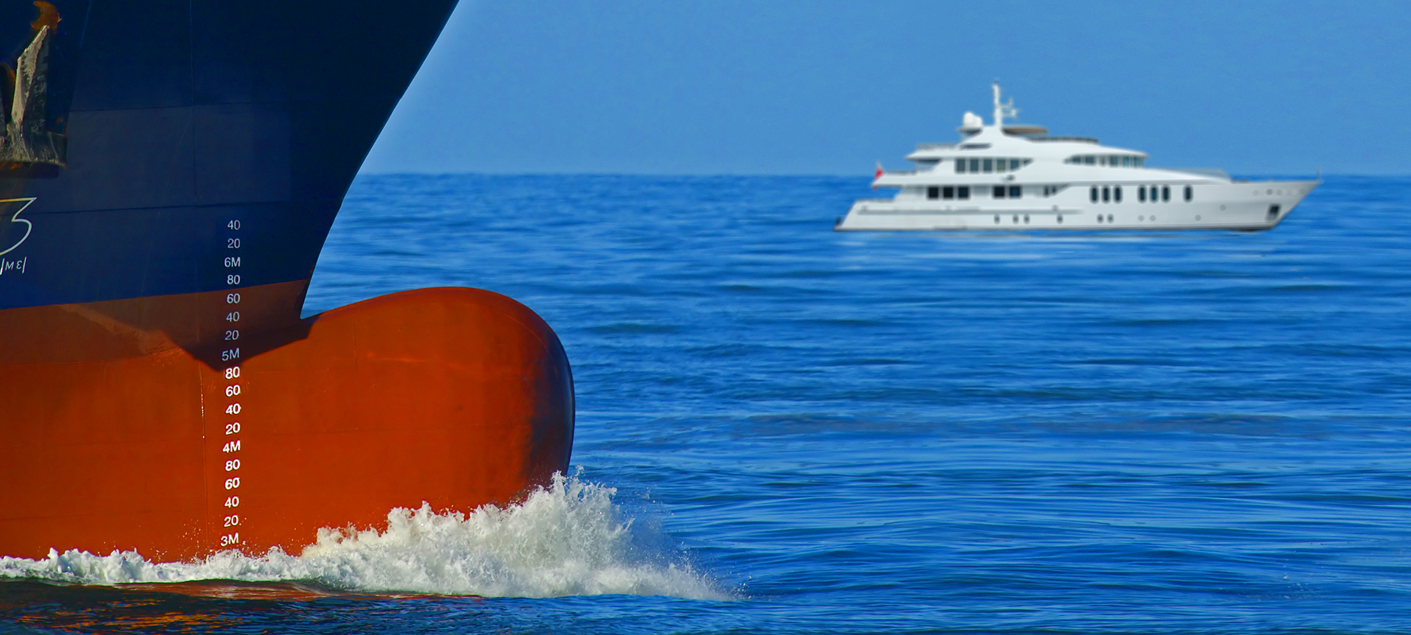

Regulatory Update
& Initiatives
Jason Collings,
Director, Safety & Compliance (Operations)

Slide 2
What’s New?

Slide 3
Summary
Seafarer Welfare
Employment contracts for seafarers on pleasure vessels
Guidance on responding to Harassment and Sexual Misconduct
Twin occupancy crew cabins for yachts up to 10,000GT
Operations
Additional guests on yachts in private use
Record of Auxiliary Tender (ROAT)
Electro-Technical Officers (ETO)
Single main engine accepted for grade of STCW CoC
Non-STCW Certificates of Competency
Online STCW training
Pilot boarding arrangements

Slide 4
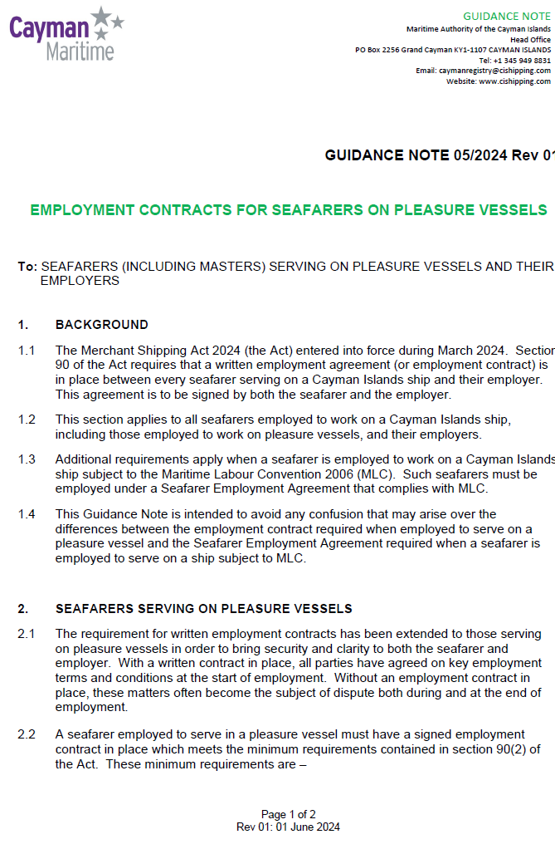
EMPLOYMENT CONTRACTS FOR SEAFARERS ON PLEASURE VESSELS
Guidance Note 05/2024 refers
Section 90 of The Merchant Shipping Act applies.
Written employment agreement (or employment contract) is required between every seafarer serving on a Cayman Islands ship and their employer.
MLC vessels still require approved SEAs.

Slide 5
EMPLOYMENT CONTRACTS FOR SEAFARERS ON PLEASURE VESSELS
Minimum requirements include:
the amount of wages and method of payment;
the production of monthly wage accounts;
any wage deductions permitted by the Act;
the entitlement to repatriation and medical expenses;
any entitlement to leave;
any notice period required;
the agreed place for the return of the seafarer; and
the governing law.

Slide 6
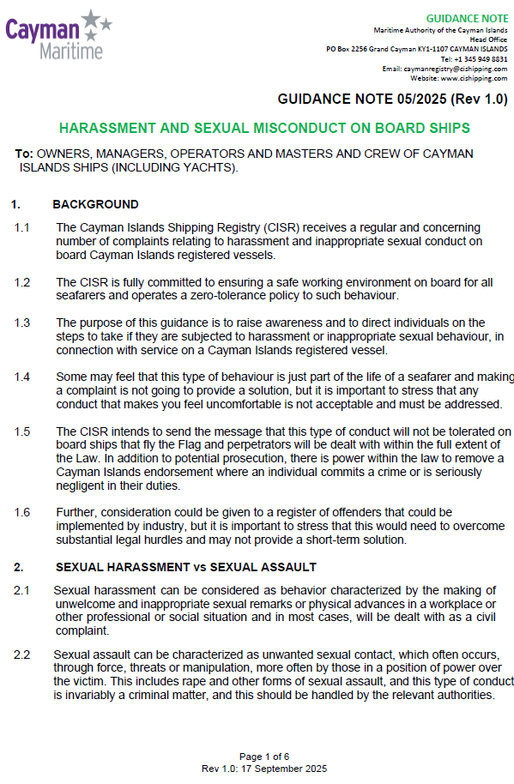
Harassment & Sexual Misconduct
Guidance Note 05/2025 issued to raise awareness and provide clearer guidance on how to respond if subjected to harassment or inappropriate sexual behaviour.
STCW Basic Training – Personal Safety and Social Responsibilities (PSSR) updated, enters force 01 Jan 2026. Will include training on the prevention of and response to violence and harassment, including sexual harassment, bullying, and sexual assault.
MLC B 4.3 requires Companies to ensure H&S policies include bullying and harassment.
Seafarer feedback and complaints will be a focus area during DoC audits
IMO discussing ISM Code amendments specifically to deal with sexual harassment, bullying and sexual assault.

Slide 7
Harassment & Sexual Misconduct
Merchant Shipping Act 2024 imposes a responsibility on the Shipowner and the Master to ensure a safe environment for all crew.
Section 114 creates an offence for any seafarer that engages in any act leading to the death or the serious injury to any person.
Section 118 provides for disqualification of a seafarer (removal of Cayman Islands Endorsement) due to the misconduct of the seafarer.
International Seafarer’s Welfare and Assistance Network (ISWAN).
The International Transport Workers Federation (ITF).
The International Chamber of Shipping.
Seafarer Union - Nautilus International.

Slide 8
REG Yacht Code – Crew Cabins
REG Yacht Code Part A (Large Yachts) now permits twin occupancy crew cabins for seafarers who are not performing the duties of officers on yachts up to 10,000GT.
Following additional requirements apply:
Cabins to have ensuite facilities
Officer’s lounge
Crew lounge
Crew gym
Case by case above 10,000GT.

Slide 9
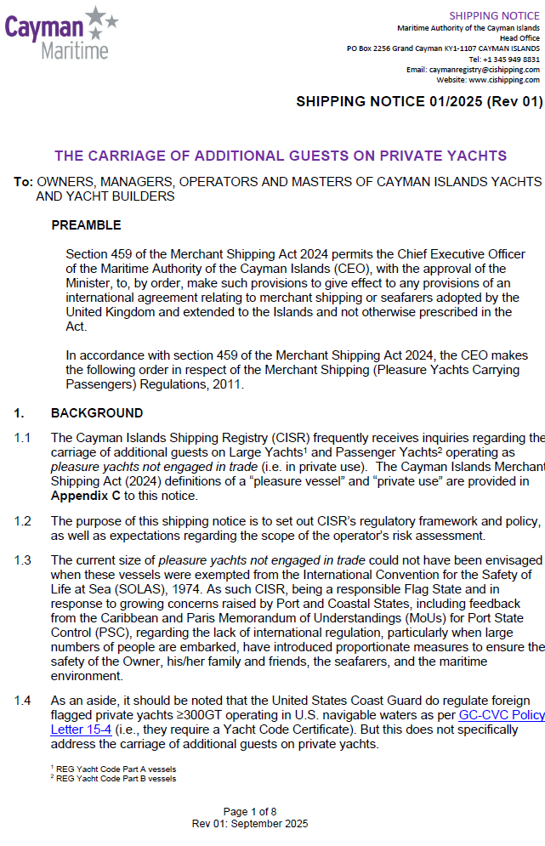
Additional Guests (Private Use)
Shipping Notice 01/2025 refers
ISM managed yachts in private use certified under the REG Yacht Code may carry additional guests with no need to request a dispensation letter.
Numbers must not exceed 36 for Large Yachts or 60 for Passenger Yachts

Slide 10
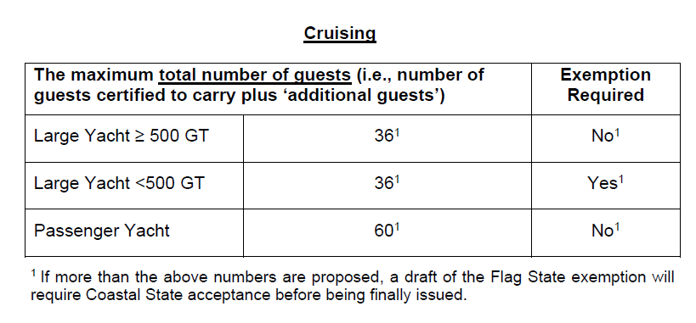
Additional Guests (Private Use)

Slide 11
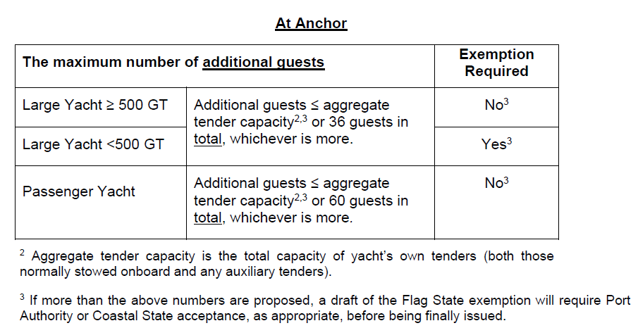
Additional Guests (Private Use)

Slide 12
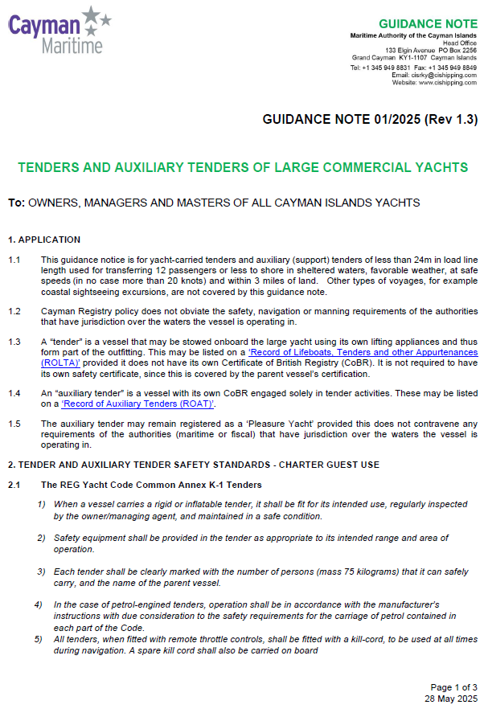
Tenders & Auxiliary Tenders
CIGN 01/2025 refers
An Auxiliary Tender has its own COBR solely for tender activities
Record of Auxiliary Tender (ROAT) to assist with charter licensing
Guest transfer ashore only, <3 NM, up to 12 guests
Small Commercial Vessel cert or Cayman Islands Auxiliary Tender SoC
Record of Lifeboats, Tenders and Other Appurtenances (ROLTA). Stowed onboard, no separate COBR or safety cert

Slide 13
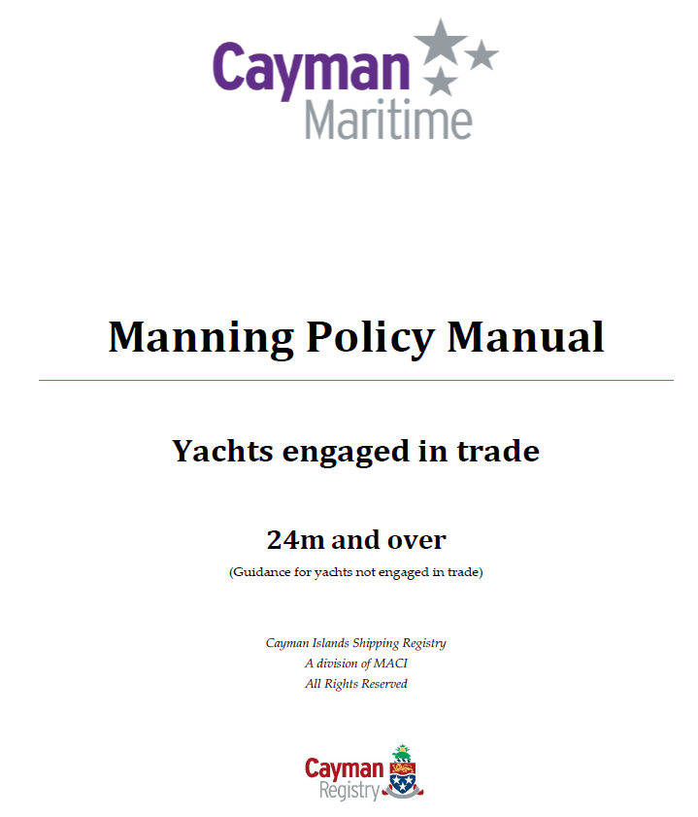

Slide 14
Electro Technical Officers (ETO)
Sect.19 Electro Technical Officers (ETO) now includes when we would expect an ETO to be recorded on the MSMD.
For all vessels with high voltage (HV) i.e. generated/distributed at more than 1kV it’s expected that an ETO will be required.
ETO shall hold a STCW III/6 CoC.
It’s recommended that Engineer Officers serving onboard diesel electric vessels with voltage less than 1KV complete HV training.

Slide 15


Single highest rated engine
Propulsion power for yachts with multiple engine configurations will now be based on the single highest rated engine or thruster pod (KW)
Example: 499GT, 4,500KW

Slide 16
Yachts with steerable propulsion
Operators of all yachts (i.e. both commercial and pleasure yachts in private use) with steerable propulsion e.g. azimuth thrusters shall receive the relevant specialised training and familiarisation on the operation and control of the system.
Prior to being assigned the relevant shipboard duties and prior to sailing.

Slide 17
Non-STCW Certificates of Competency
These Certificates are not eligible for Flag State Endorsements as they are not issued under the STCW Convention:
RYA Yacht Master Coastal;
IYT Master of Yachts Coastal;
RYA Yachtmaster Offshore;
IYT Master of Yachts Limited
RYA Yachtmaster Ocean;
IYT Master of Yachts Unlimited
MEOL and AEC
The listed RYA and IYT certificates also qualify the seafarer to hold a position as a Yacht Rating subject to the commercial endorsement requirement for RYA certificates
Upgrade available to:
Master Code Vessels <200GT CoC
OOW <500GT CoC
UK MSN 1858 refers

Slide 18
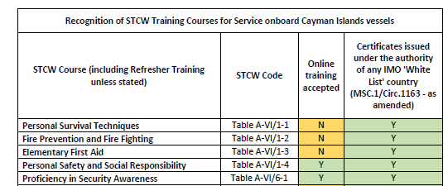
Online STCW Training
Cayman Islands Shipping Notice CISN 01-2024 section 14 refers.
Online training is not accepted for STCW training courses which have practical elements e.g. Fire fighting, first aid etc.
Beware of any companies stating that Cayman accept their fully online basic four STCW courses….. we do not!

Slide 19
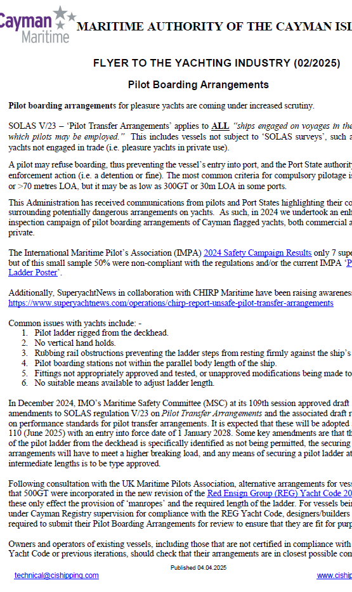
Pilot Boarding Arrangements on Yachts Safety Flyer (02/2025)
SOLAS V/23 – ‘Pilot Transfer Arrangements’ applies to ALL “ships engaged on voyages in the course of which pilots may be employed”
A pilot may refuse boarding, thus preventing the vessel’s entry into port, and the Port State authority may take enforcement action (i.e. a detention or fine).
In 2024 we undertook an enhanced inspection campaign of pilot boarding arrangements of Cayman flagged yachts, both commercial and private.

Slide 20
Pilot Boarding Arrangements on Yachts Safety Flyer (02/2025)
Common issues with yachts include: -
Pilot ladder rigged from the deckhead.
No vertical hand holds.
Rubbing rail obstructions preventing the ladder steps from resting firmly against the ship’s side.
Pilot boarding stations not within the parallel body length of the ship.
Fittings not appropriately approved and tested, or unapproved modifications being made to ladders.
No suitable means available to adjust ladder length.

Slide 21
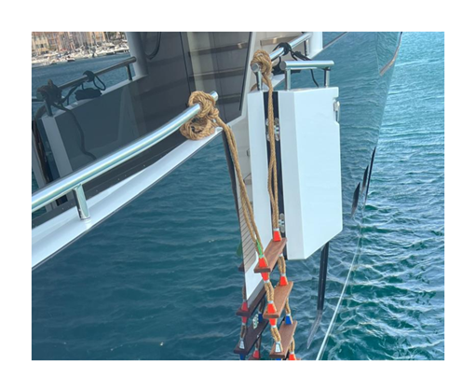
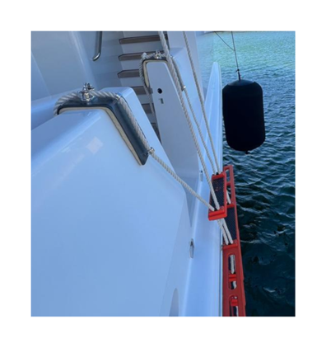
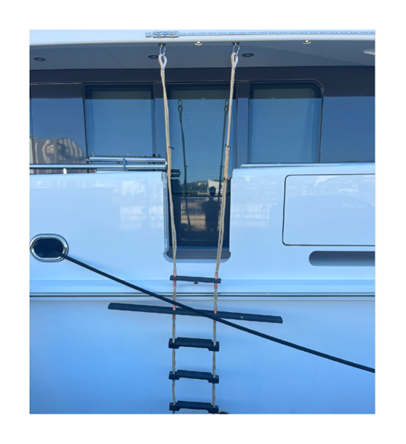
Improper securing of pilot ladders to handrails or fender saddles, no vertical handholds
Pilot ladder secured to deckhead (prohibited from 01.01.2028), no vertical handholds, rubbing rail obstruction (albeit relatively minor in this instance)

Slide 22
Pilot Boarding Arrangements on Yachts Safety Flyer (02/2025)
SOLAS amendments adopted at MSC 110 (June 2025) with an entry into force date of 1 January 2028
Some key amendments are that the rigging of the pilot ladder from the deckhead is specifically identified as not being permitted
Securing arrangements will have to meet a higher breaking load
Any means of securing a pilot ladder at intermediate lengths is to be type approved
Following consultation with UK Pilots Association; REG YC Part A <500GT vessels may omit manropes and the required length of the ladder is just from the WL

Slide 23
Any questions?

