Slide 1
UK Yacht CoC’s - Modernisation
Relevant Training offering opportunities for progression
Ajit Jacob
Chief examiner, Assistant Director – Seafarer Technical Delivery
25/09/25

Slide 2
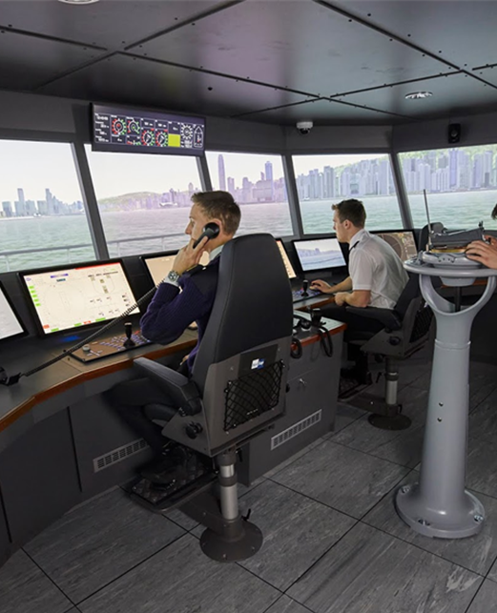
Implementation of CT&M programme – September 2025
Switch from Paper Charts to ECDIS
Adoption of Simulator training in lieu of actual sea-service 1:3 up to maximum of 1 month
Introduction of data skills training, cybersecurity training
Workshops now incorporate modern automation and technology,
Simulator-based learning is being integrated with core subjects like mechanics and thermodynamics to emphasise the application of knowledge.
Common Delivery of some modules.

Slide 3
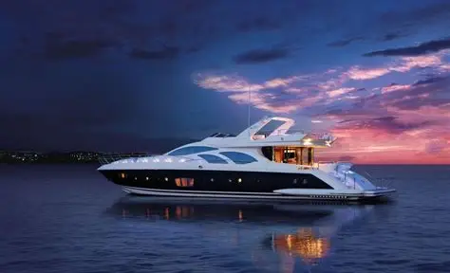
Purpose of Yacht Unlimited CoC’s
Supporting Career Advancement​
Ensures seafarers in the yacht sector can advance professionally without being disadvantaged.
Structured Progression Pathway​
The Yacht Unlimited CoC provides a clear career progression tailored for seafarers in the large yacht sector.​
Sector-Specific Flexibility​
Acknowledges unique operational demands of large yachts, excluding cargo competencies but covering navigation and safety.​
Compliance with International Standards​
The CoC aligns with STCW Convention standards ensuring global recognition and competence for yacht officers.​

Slide 4
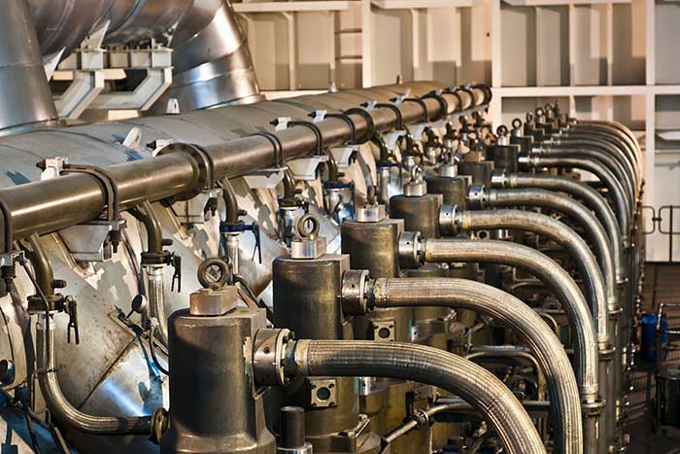
MCA Small Vessel & Yacht Engineering Certification
Notes:
This is an introduction to the new Marine Surveyor Development Scheme. There are notes on each slide which provides more detail on the content of each slide.

Slide 5
Small Vessel Engineering Modernisation
Modernised principles will be integrated into Small Vessel training pathway.
The syllabuses for the Small Vessel written exam modules will be reviewed with the aims to:
remove outdated machinery and procedures
include current technologies and industry best practices relevant to small vessels
The Small Vessel written exams will transition to the MCA’s new digital assessment platform.

Slide 6
Yacht restricted Unlimited kW CoC
Designed to meet the academic standards of the Unlimited CoC pathway
Introduction of updated syllabuses tailored for Oral and Engineering Knowledge exams for large yachts, excluding topics irrelevant to onboard environments, such as 2-stroke diesel engines
Yacht restricted written exams will be administered via the MCA’s new digital assessment platform
Will offer increased flexibility regarding sea service requirements for Yacht Engineers
Ensures continued transferability across all MCA Engineering Pathways
Pathway for existing 3000GT/9000kW Chief Engineer CoC holders to achieve Yacht restricted Unlimited kW CoC.
Notes:
Alternate fuels at the moment are more suitable for these types of vessels due to size and trading patterns therefore more likely to appear as test cases before being fitted to larger ships.

Slide 7
Approved Electrical Propulsion Course 1 (AEPC1)
The MCA, in partnership with training providers, industry stakeholders, and shipowners, has established course standards focused on battery safety and electrical propulsion.
These courses equip learners with the essential knowledge, comprehension, and skills required to safely and effectively operate vessels already employing electric drives with battery technology.
The training spans 35 hours and aligns with the MCA’s Small Vessel Approved course framework, running parallel with the Approved Engine Course 1.
The course is divided into two parts:
Part 1 addresses battery safety and is relevant to all crew members.
Part 2 focuses on the operational and technical aspects of electric drives, targeting crew responsible for managing these systems onboard.

Slide 8
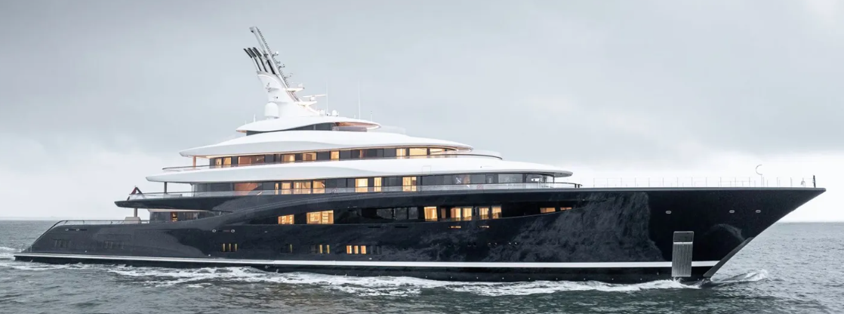
Alternate Fuels
The MCA has collaborated with industry partners, shipowners, and flag states to create training programs on alternative fuels.
Each fuel type has distinct risks, necessitating specialized training for safe use.
Bunkering staff must be trained in fuel-specific safety, including cryogenic protocols, toxicology, and handling of gaseous fuels as needed.
Hydrogen Pilot course delivered September 2024:
Part 1 (1 day) – Basic Hydrogen awareness - aimed at those seafarers completing IGF basic training
Part 2 (1 day)– Advanced Hydrogen awareness - aimed at those seafarers completing IGF basic & advanced training including bunkering.
Practical bunkering exercise on actual vessel (additional to the 1-day part 2 training)
Courses in development for:
Ammonia
Methanol
IGF 30-day equivalency course

Slide 9
Deck- Progression to Yacht unlimited CoC
Notes:
This is an introduction to the new Marine Surveyor Development Scheme. There are notes on each slide which provides more detail on the content of each slide.

Slide 10
Chief Mate Yacht Unlimited, Reg II/2 CoC
In line with Modernised Syllabus
Eligibility Requirements
Master Yacht <3000 GT, II/1, or
OOW Unlimited CoC with required yacht sea service
Pass relevant academic modules
Pass MCA assessments
Hold relevant ancillary certificates
Details in new amendments of MSN 1858.

Slide 11
Chief Mate Yacht Unlimited CoC

Slide 12
Master Yacht Unlimited, Reg II/2 CoC
Pre-requisite: Hold Chief Mate Yacht Unlimited CoC
Sea service Requirements
OOW Unlimited route with required Yacht sea service, or
Chief Mate route with required Yacht sea service
Existing Master <3000 GT with 6 months Yacht sea service
Pass MCA Orals
Hold relevant ancillary certificates
Details in new amendments of MSN 1858.

Slide 13
Master Yacht Unlimited CoC

Slide 14
Next Steps
Workshop on 29th September
Formation of Working Groups – Deck and Engineering
Collaborate with Industry, Training Providers and seafarers
Finalise the new route, publish amendment to MSN 1858 & 1859
Target Date: April 26
Implementation of Digital Assessment Platform
Increased use of Simulators
Oral exams – extension of Part A to all Yacht CoC’s

Slide 15
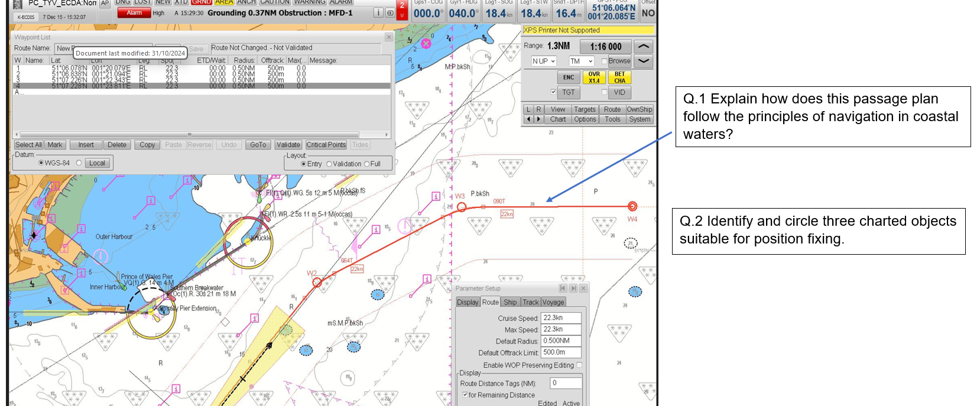
Modernised sample question for the MCA safety critical assessment

Slide 16
Thank You!
Yacht CoC Modernisation – Supporting career progression while maintaining STCW standards.
Invite Collaboration to Large Yacht Working Group – exams@mcga.gov.uk

