Slide 1
OCEAN MAPPING
&
CROWDSOURCED
BATHYMETRY
Dr Mathias Jonas, Secretary-General, IHO

Slide 2
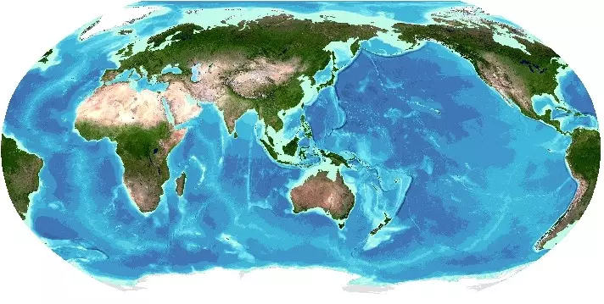
The Ocean topography we know today
The grid was published in August 2025 and is the seventh GEBCO grid developed through The Nippon Foundation-GEBCO Seabed 2030 Project.(Image credit: GEBCO)

Slide 3
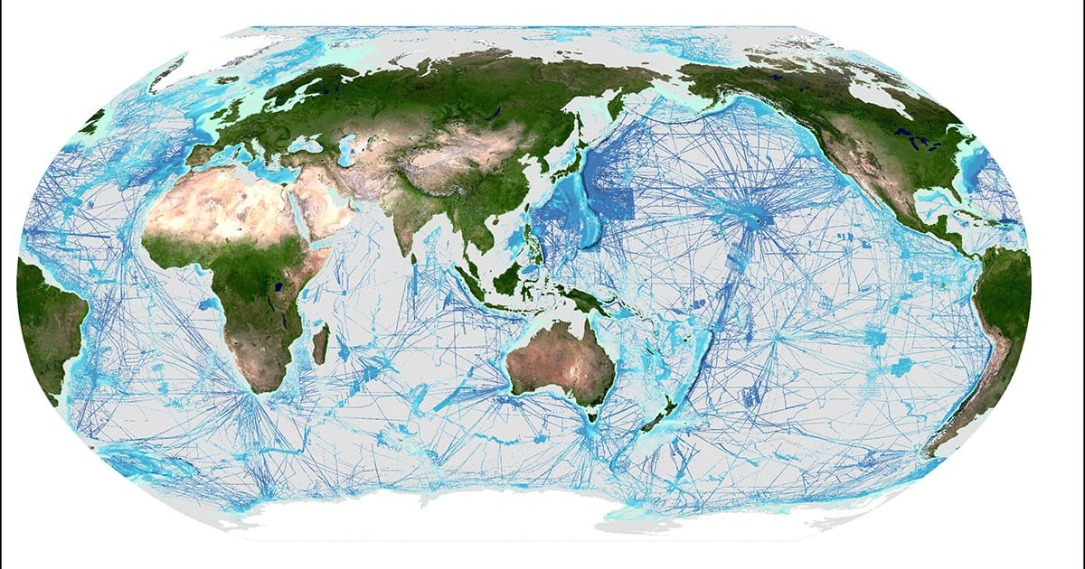
Depth measurements = bathymetric data
~ 27% of the world’s ocean depths have been directly measured
~50% of the world’s coastal waters shallower than 200 meters remain completely unsurveyed.
The rest of the data used to compile seafloor maps are inferred depths from satellite observations with low accuracy and suppression of details.
Any contribution of depth measurements – done by professionals or amateurs - helps to improve.
Areas shown in shaded blue represent parts of the seafloor considered mapped in the GEBCO 2025 Grid. (Image credit: Seabed 2030)

Slide 4
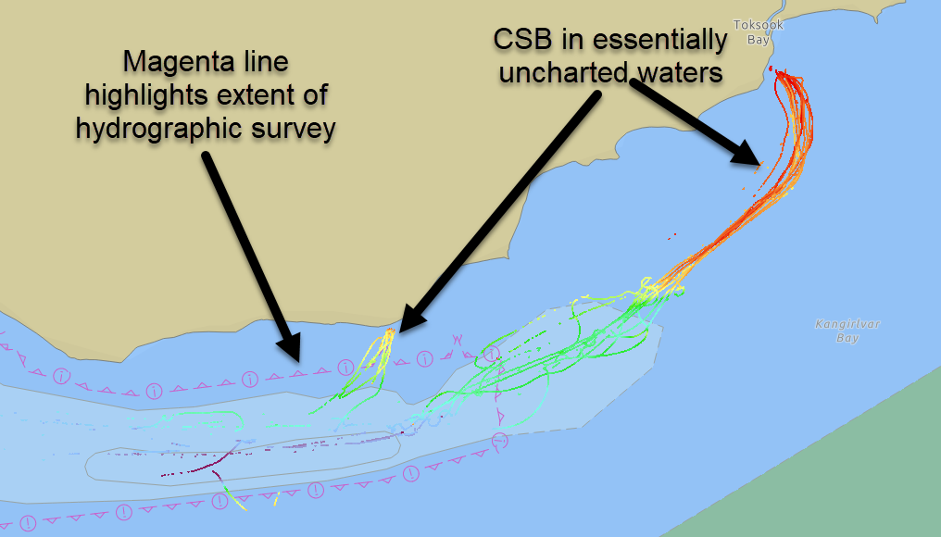
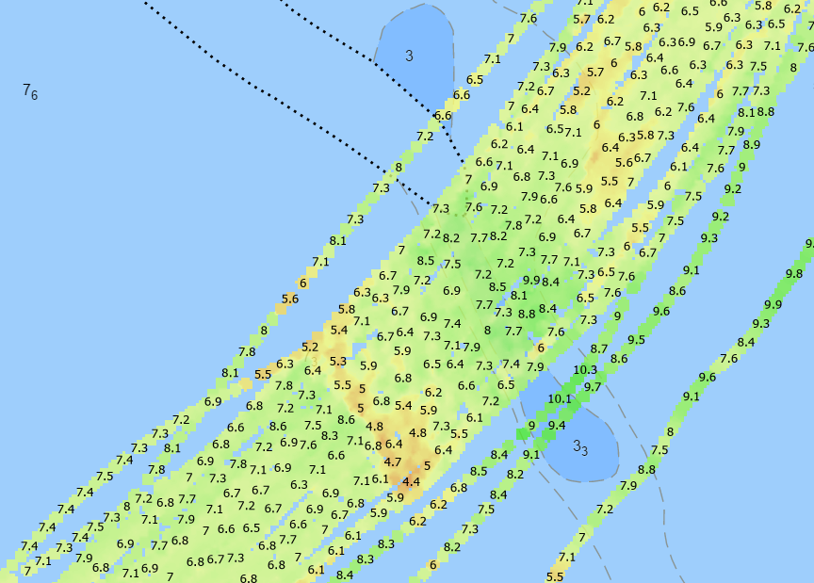
Crowdsourcing = Citizen Science
Data with scientific, commercial & research value at no cost to the public sector
Fill gaps where data is scarce
Useful along shallow, complex coastlines
Identify uncharted features
Assist in verifying charted information
Confirm whether charts are appropriate for the latest traffic patterns.
CSB tracks collected through and past the extent of a U.S. hydrographic survey in Alaska. (Credit: NOAA)
Used to identify mischarted features (Credit: NOAA)
  ...but only if vessels collect and donate depth information while on passage

Slide 5
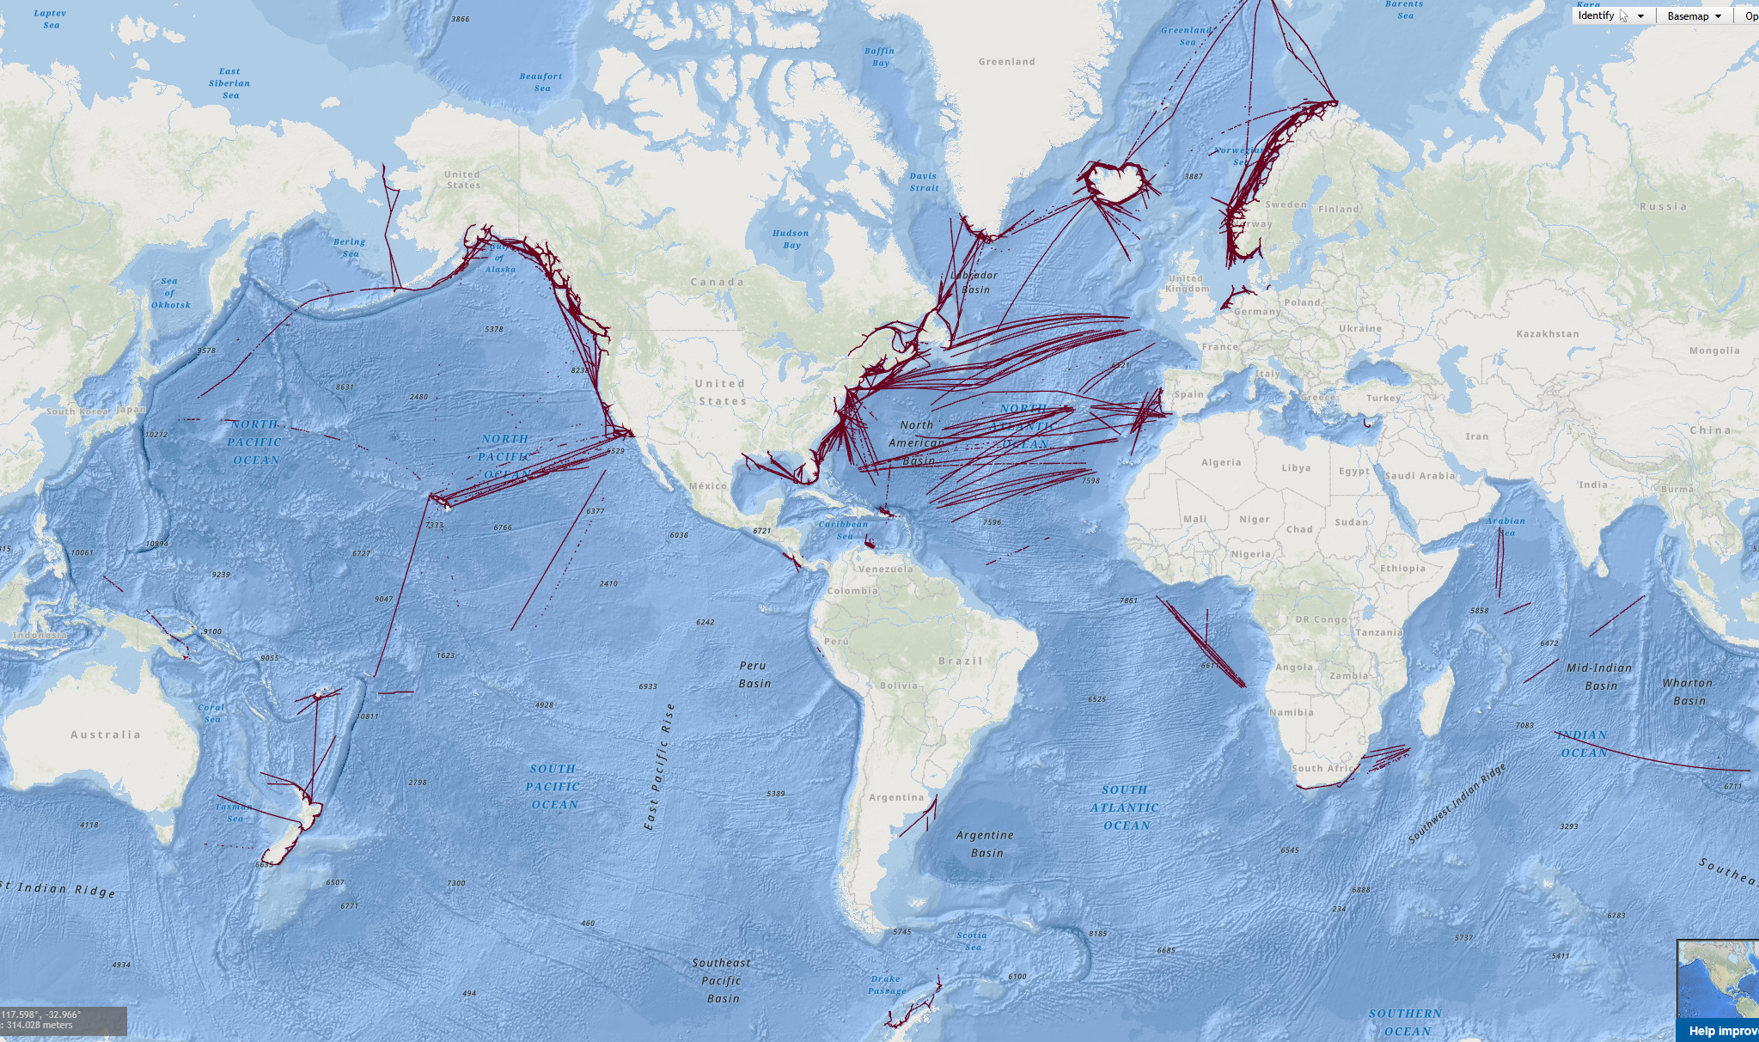
Current CSB DATA contributions
Rosepoint Navigation Systems
Alcatel Submarine Networks
AquaMap
COMIT USF
FarSounder
Great Lakes Observing System (GLOS)
MacGregor Germany
OMS Group
Orange Force Marine (OFM)
Petroleum Geo-Services (PGS)
Seabed 2030
International SeaKeepers Society
Carnival Corp
>500 contributing vessels
~707,000 data contributions
~53 Gb total data volume
IHO in collaboration with NOAA/US has setup a system which makes data donation easy
ncei.noaa.gov/iho-data-centre-digital-bathymetry

Slide 6
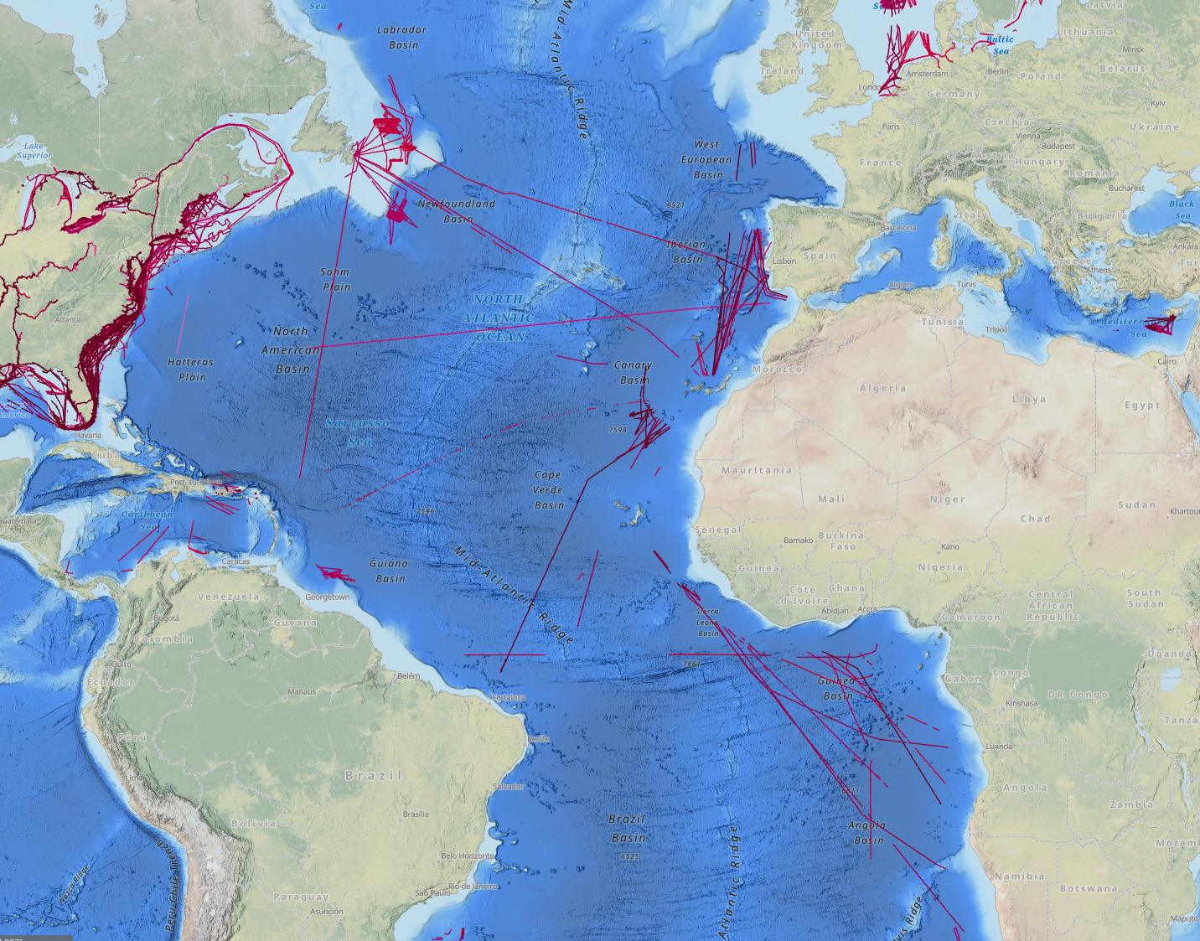
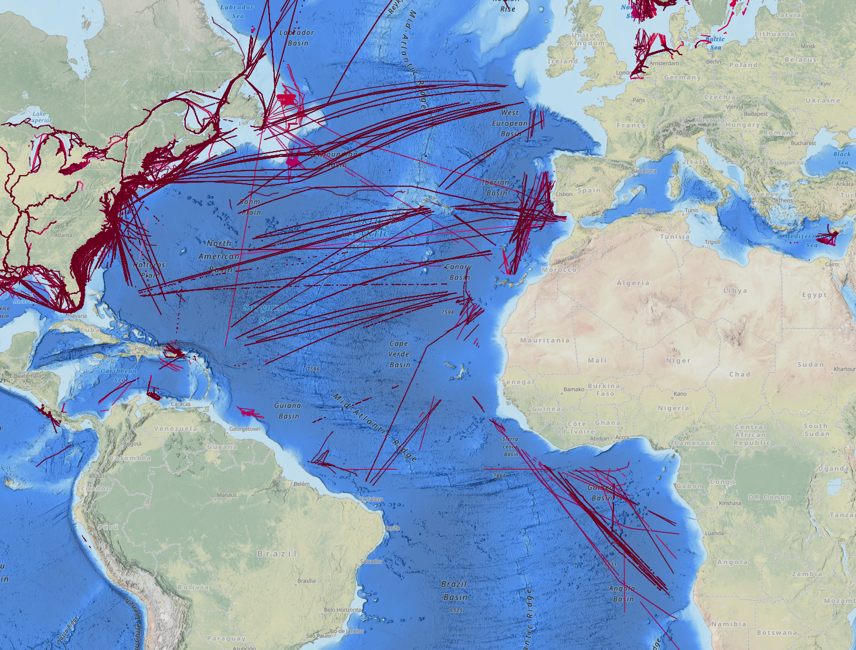
Carnival Corp. contributions began in March 2025
Data holdings from September 2024.
Data holdings from September 2025.
Increase in data in the Atlantic due to new contributions from Carnival Corp.

Slide 7
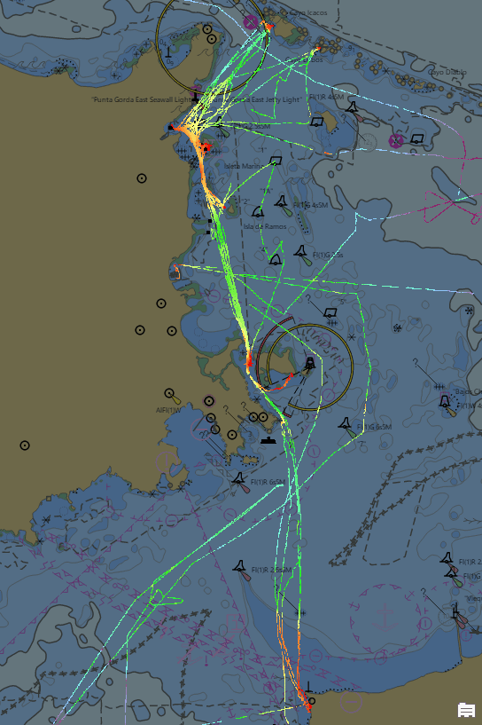
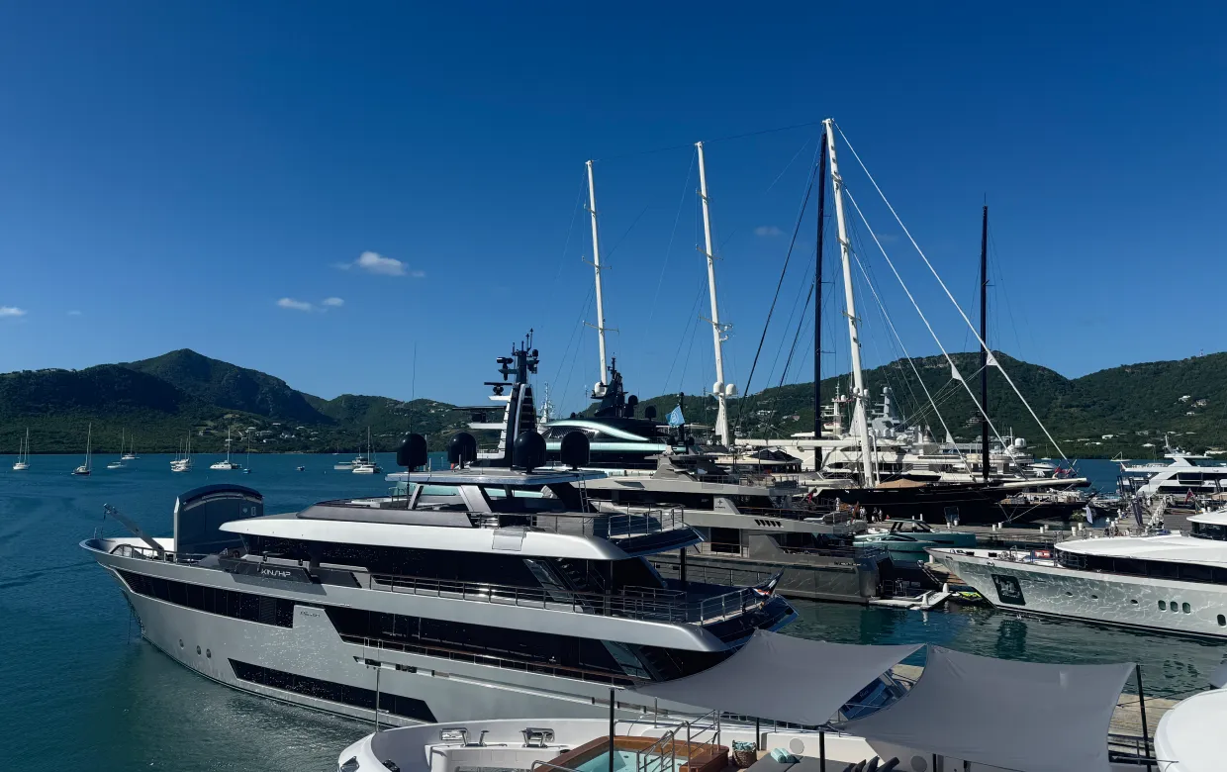

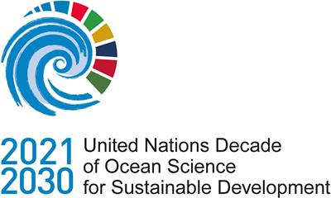
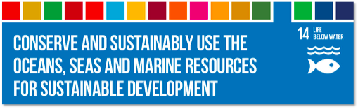
Digital philanthropy
Explorer yachts explore the world
Often in areas where data is sparse, non-existent or of poor quality. In these areas, data contributions can have the greatest impact!
Join a global initiative
No effort for the ship‘s crew! Data can be shared, thanks to the built-in navigation software.
Make our ocean safer
By contributing data, explorer yachts can help to avoid groundings and environmental damage, making the ocean safer. They are also supporting initiatives to protect the ocean.
This nautical chart highlights CSB data collected in part by SeaKeepers DISCOVERY Vessels.
The information will help characterize the seafloor shape between Puerto Rico, Culebra, and Vieques.
(Both images credit: SeaKeepers)

